Slide 1
Bike Sharing Demand Analysis
Bike Sharing Demand Analysis
Next Hikes IT Solutions
Created by:- Saleha Rahim

Slide 2
Introduction
This project analyzes bike-sharing data to understand rental demand patterns.
The goal is to identify how factors like time, weather, and user type affect bike rentals.

Slide 3
Problem Statement
Bike rental demand changes based on different conditions such as weather, time, and user behavior.
The objective is to analyze these patterns to improve business decision-making.

Slide 4
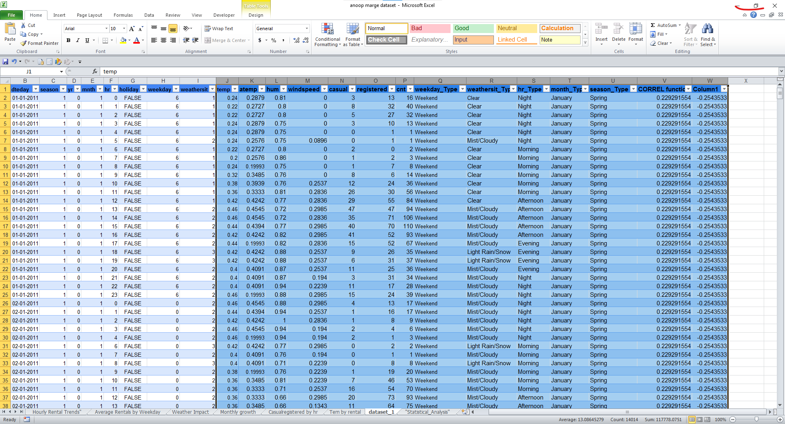
Dataset Overview
The dataset contains hourly and daily bike rental data.
Main columns:
Date (dteday)
Hour (hr)
Weather (weathersit)
Temperature (temp)
Users (casual, registered)
Total Rentals (cnt)

Slide 5


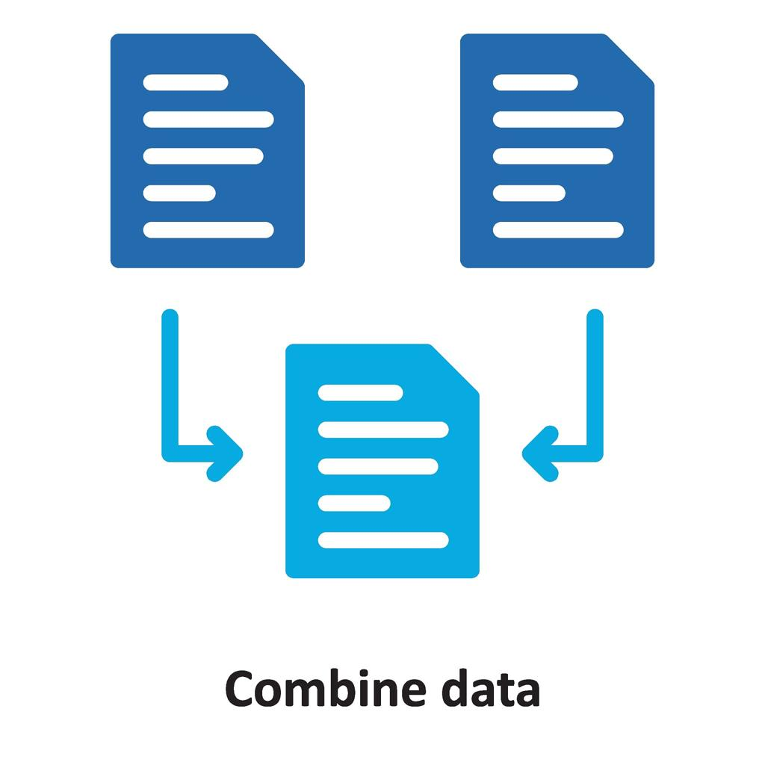
Data Cleaning
Removed missing values
Handled null data
Corrected data types
Removed duplicates
Formatted dataset properly

Slide 6
Data Merging
Combined 3 datasets using Power Query
Used common keys: instant, dteday, hr
Created a single clean dataset for analysis
[Dataset 1] [Dataset 2] [Dataset 3
↓ ↓ ↓
[Final Dataset]

Slide 7
Key Features Created
Weekend / Weekday classification – 📅
Weekday = Working days Weekend = Holiday days
Demand Level (High / Low) - 📊
High demand →"Higher rentals" Low demand → "Lower rentals"
Temperature category (Hot / Cold / Moderate)- 🌡
"Total Users (Casual + Registered)" - 👥
⏰ 🌦️ 👥

Slide 8
Analysis - Hourly Demand
Peak demand observed during morning and evening hours
Low demand during late night
Useful for scheduling bikes efficiently

Slide 9
Analysis - Weather Impact
Clear weather shows highest rentals
Rainy or bad weather reduces demand
Weather plays a key role in rentals
Clear weather leads to higher rentals.

Slide 10
Analysis - Monthly Trend
Demand increases during summer months
Lower demand in winter
Seasonal patterns are clearly visible
Demand increases during summer months.

Slide 11
User Analysis
Registered users contribute more Rentals
Casual users mainly active on weekends
Shows difference in user behavior
Registered users contribute more rentals.

Slide 12
Dashboard Overview
Interactive dashboard created using Excel
Includes multiple charts and slicers
Helps in dynamic data filtering and insights

Slide 13
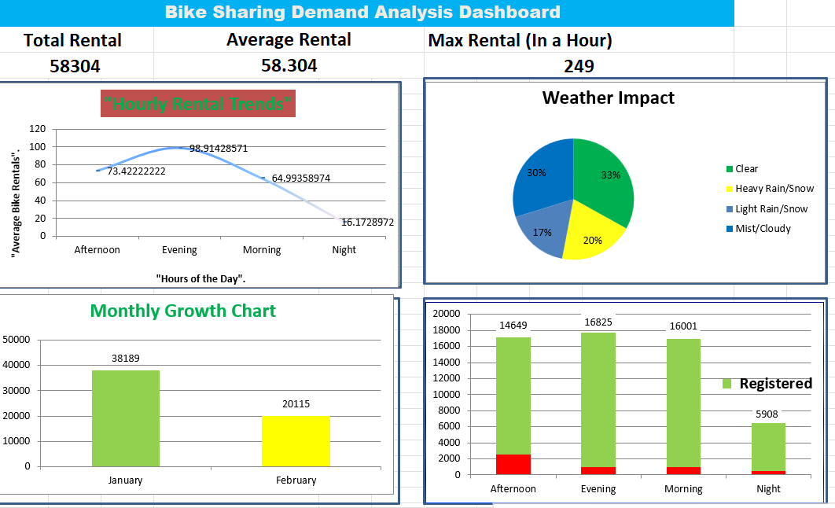

Slide 14
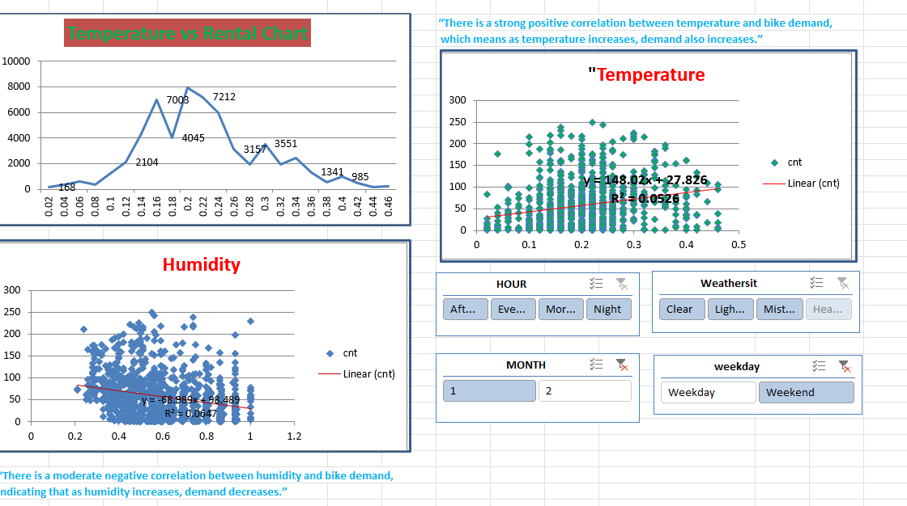

Slide 15
Tools Used
"Microsoft Excel"–Data analysis and dashboard creation
Power Query – Data cleaning and merging
Pivot Tables – Data summarization
Charts – Data visualization
Slicers – Interactive filtering
📊 Microsoft Excel 🔗 Power Query 📈 Pivot Tables 📉 Charts 🎛 Slicers vs filtering

Slide 16
Correlation Analysis
Temperature vs Rentals
Humidity vs Rentals
Temperature shows a positive correlation with bike rentals. Humidity shows a weak negative correlation. Weather plays an important role in demand.

Slide 17
Conclusion
Bike demand depends on time, weather, and user type
Peak hours and seasons identified
Data helps improve business planning and decision-making

Slide 18
Thank You
Feel Free to Ask Questions?

